Slide 1
CHAPTER 16
HYBRID SOFT COMPUTING TECHNIQUES
“Principles of Soft Computing, 2nd Edition”
by S.N. Sivanandam & SN Deepa
Copyright © 2011 Wiley India Pvt. Ltd. All rights reserved.

Slide 2
HYBRID SYSTEMS
Neural Network Systems
Neural networks are the simplified models of the human nervous systems mimicking our ability to adapt to certain situations and to learn from the past experiences.
Fuzzy Logic
Fuzzy logic or fuzzy systems deal with uncertainty or vagueness existing in a system and formulating fuzzy rules to find a solution to problems.
Genetic Algorithm
Genetic algorithms inspired by the natural evolution process are adaptive search and optimization algorithms.
“Principles of Soft Computing, 2nd Edition”
by S.N. Sivanandam & SN Deepa
Copyright © 2011 Wiley India Pvt. Ltd. All rights reserved.

Slide 3
The main aim of the concept of hybridization is to overcome the weakness in one technique while applying it and bringing out the strength of the other technique to find solution by combining them.
Neural networks are good at recognizing patterns but they are not good at explaining how they reach their decisions.
On the contrary, fuzzy logic is good at explaining the decisions but cannot automatically acquire the rules used for making the decisions. Also, the tuning of membership functions becomes an important issue in fuzzy modeling. Genetic algorithms offer a possibility to solve this problem.
These limitations act as a central driving force for the creation of hybrid soft computing systems where two or more techniques are combined in a suitable manner that overcomes the limitations of individual techniques.
“Principles of Soft Computing, 2nd Edition”
by S.N. Sivanandam & SN Deepa
Copyright © 2011 Wiley India Pvt. Ltd. All rights reserved.

Slide 4
The use of hybrid systems is growing rapidly with successful applications in areas such as
engineering design
stock market analysis and prediction
medical diagnosis
process control
credit card analysis and
few other cognitive simulations.
“Principles of Soft Computing, 2nd Edition”
by S.N. Sivanandam & SN Deepa
Copyright © 2011 Wiley India Pvt. Ltd. All rights reserved.

Slide 5
VARIOUS HYBRID SYSTEMS
In this text book, the following three different hybrid systems are discussed:
      Neuro fuzzy hybrid system;
      neuron genetic hybrid system;
      fuzzy genetic hybrid systems.
“Principles of Soft Computing, 2nd Edition”
by S.N. Sivanandam & SN Deepa
Copyright © 2011 Wiley India Pvt. Ltd. All rights reserved.

Slide 6
NEURO FUZZY HYBRID SYSTEMS
Definition:
A neuro-fuzzy hybrid system (also called fuzzy neural hybrid) is a learning mechanism that utilizes the training and learning algorithms from neural networks to find parameters of a fuzzy system.
Advantages of neuro fuzzy hybrid systems:
It can handle any kind of information (numeric, linguistic, logical, etc.).
It can manage imprecise, partial, vague or imperfect information.
It can resolve conflicts by collaboration and aggregation.
It has self-learning, self-organizing and self-tuning capabilities.
It doesn’t need prior knowledge of relationships of data.
“Principles of Soft Computing, 2nd Edition”
by S.N. Sivanandam & SN Deepa
Copyright © 2011 Wiley India Pvt. Ltd. All rights reserved.

Slide 7
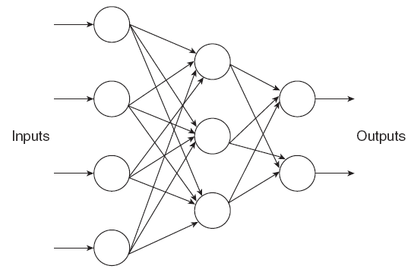
ARCHITECTURE OF NEURO FUZZY HYBRID SYSTEMS
The general architecture of neuro-fuzzy hybrid system is as shown in Figure 1.
Fig 1
The architecture is a three-layer feed forward neural network model. It can also be observed that the first layer corresponds to the input variables, and the second and third layers correspond to the fuzzy rules and output variables, respectively. The fuzzy sets are converted to (fuzzy) connection weights.
“Principles of Soft Computing, 2nd Edition”
by S.N. Sivanandam & SN Deepa
Copyright © 2011 Wiley India Pvt. Ltd. All rights reserved.

Slide 8
TYPES OF NEURO FUZZY HYBRID SYSTEMS
NFSs can be classified into the following two systems:
Cooperative NFSs.
2. General neuro-fuzzy hybrid systems.
“Principles of Soft Computing, 2nd Edition”
by S.N. Sivanandam & SN Deepa
Copyright © 2011 Wiley India Pvt. Ltd. All rights reserved.

Slide 9
CO-OPERATIVE NEURO FUZZY SYSTEMS
In this type of system, both artificial neural network (ANN) and fuzzy system work independently from each other. The ANN attempts to learn the parameters from the fuzzy system.
“Principles of Soft Computing, 2nd Edition”
by S.N. Sivanandam & SN Deepa
Copyright © 2011 Wiley India Pvt. Ltd. All rights reserved.

Slide 10
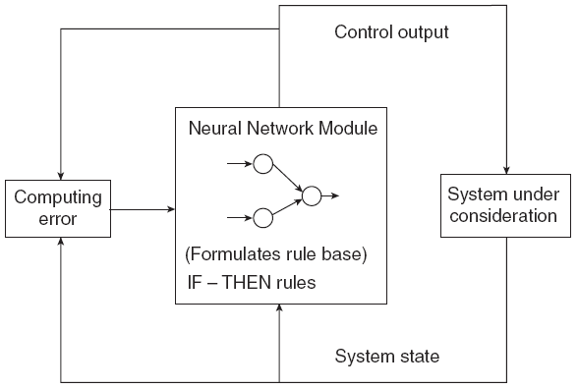
GENERAL NEURO FUZZY HYBRID SYSTEMS
General neuro-fuzzy hybrid systems (NFHS) resemble neural networks where a fuzzy system is interpreted as a neural network of special kind.
Figure 2 illustrates an NFHS
In Fig 2, the rule base of a fuzzy system is assumed to be a neural network; the fuzzy sets are regarded as weights and the rules and the input and output variables as neurons.
Fig 2
“Principles of Soft Computing, 2nd Edition”
by S.N. Sivanandam & SN Deepa
Copyright © 2011 Wiley India Pvt. Ltd. All rights reserved.

Slide 11
GENERAL NEURO HYBRID SYSTEMS
Definition:
A neuro-genetic hybrid or a genetic_neuro-hybrid system is one in which a neural network employs a genetic algorithm to optimize its structural parameters that define its architecture.
Properties of genetic neuro-hybrid systems:
The parameters of neural networks are encoded by genetic algorithms as a string of properties of the network, that is, chromosomes. A large population of chromosomes is generated, which represent the many possible parameter sets for the given neural network.
2. Genetic Algorithm _Neural Network, or GANN, has the ability to locate the neighborhood of the optimal solution quickly, compared to other conventional search strategies.
“Principles of Soft Computing, 2nd Edition”
by S.N. Sivanandam & SN Deepa
Copyright © 2011 Wiley India Pvt. Ltd. All rights reserved.

Slide 12
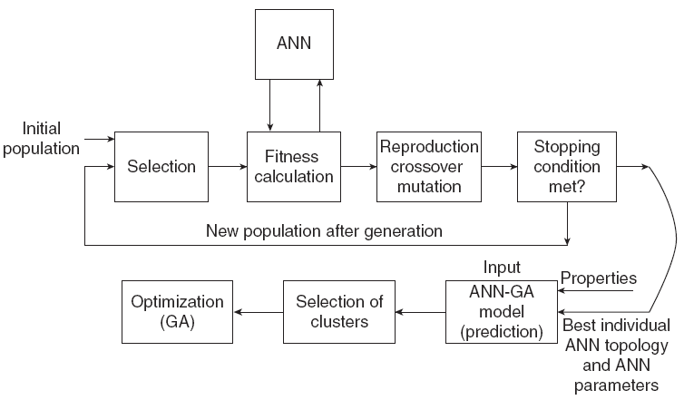
BLOCK DIAGRAM OF GENETIC NEURO HYBRID SYSTEMS
Fig 3
“Principles of Soft Computing, 2nd Edition”
by S.N. Sivanandam & SN Deepa
Copyright © 2011 Wiley India Pvt. Ltd. All rights reserved.

Slide 13
ADVANTAGES OF GENETIC NEURO HYBRID SYSTEMS
The various advantages of neuro-genetic hybrid are as follows:
GA performs optimization of neural network parameters with simplicity, ease of operation, minimal requirements and global perspective.
GA helps to find out complex structure of ANN for given input and the output data set by using its learning rule as a fitness function.
Hybrid approach ensembles a powerful model that could significantly improve the predictability of the system under construction.
“Principles of Soft Computing, 2nd Edition”
by S.N. Sivanandam & SN Deepa
Copyright © 2011 Wiley India Pvt. Ltd. All rights reserved.

Slide 14
GENETIC FUZZY HYBRID SYSTEMS
The hybridization of genetic algorithm and fuzzy logic can be performed in the following two ways:
1. By the use of fuzzy logic based techniques for improving genetic algorithm behavior and modeling GA components. This is called fuzzy genetic algorithms (FGAs).
2. By the application of genetic algorithms in various optimization and search problems involving fuzzy systems.
“Principles of Soft Computing, 2nd Edition”
by S.N. Sivanandam & SN Deepa
Copyright © 2011 Wiley India Pvt. Ltd. All rights reserved.

Slide 15
ADVANTAGES OF GENETIC FUZZY HYBRID SYSTEMS
GAs allow us to represent different kinds of structures, such as weights, features together with rule parameters, etc., allowing us to code multiple models of knowledge representation. This provides a wide variety of approaches where it is necessary to design specific genetic components for evolving a specific representation.
Genetic algorithm efficiently optimizes the rules, membership functions, DB and KB of fuzzy systems. The methodology adopted is simple and the fittest individual is identified during the process.
“Principles of Soft Computing, 2nd Edition”
by S.N. Sivanandam & SN Deepa
Copyright © 2011 Wiley India Pvt. Ltd. All rights reserved.

Slide 16
SUMMARY
This chapter has given an overview on Hybrid Soft Computing Techniques
“Principles of Soft Computing, 2nd Edition”
by S.N. Sivanandam & SN Deepa
Copyright © 2011 Wiley India Pvt. Ltd. All rights reserved.

